Slide 1
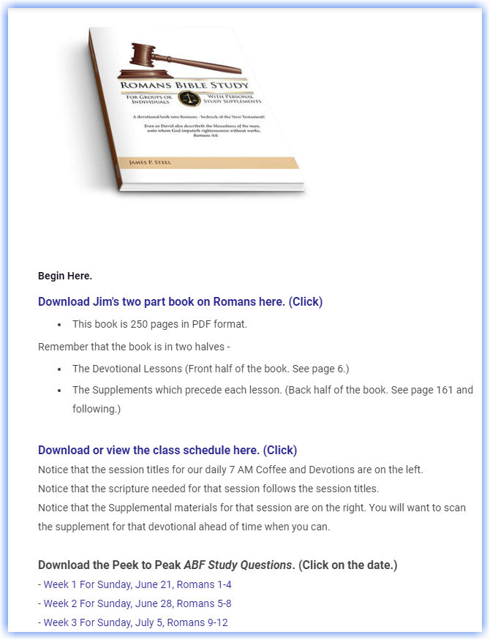
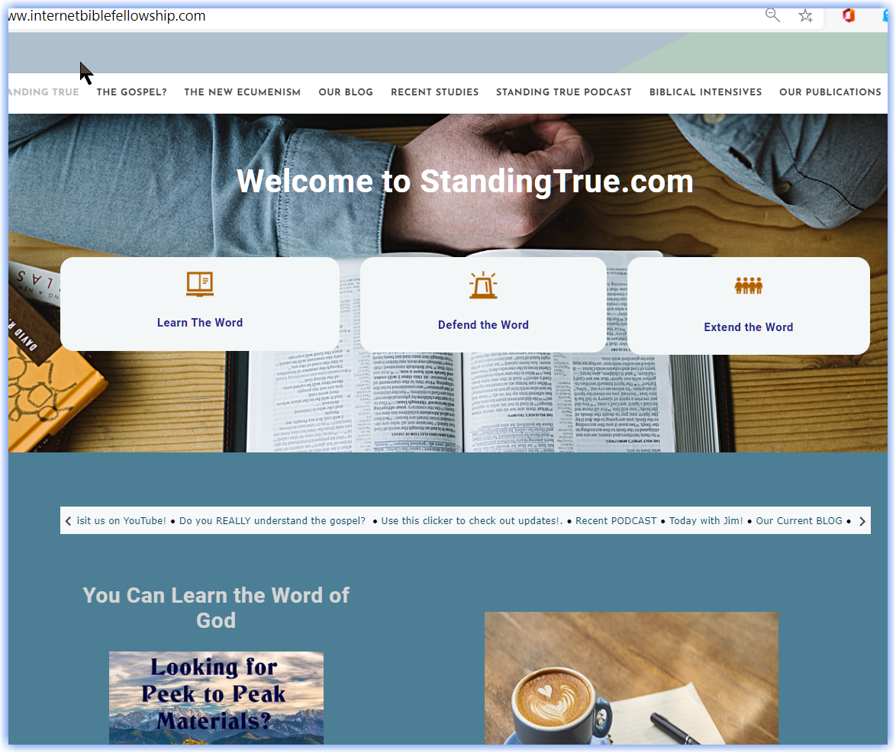
Visit
StandingTrue.com
(InternetBibleFellowship)
Click on the Peek to Peak image

Slide 2
Leaf 1 – Do not delete this text – Use for Hyperlink
Welcome to Romans!
The Righteousness of God and its Application to Man
Join us on our journey.

Slide 3
Home 3 – Do not delete this text – Use for Hyperlink
Justification & Righteousness
JUSTIFICATION DEFENDED 9:1-11
VI. JUSTIFICATION EXPERIENCED 12:1-16:27
IV. JUSTIFICATION EXTENDED
6:1-8:39
I. THE GOSPEL PRESENTED ^{1:1-17}
III. JUSTIFICATION PROVIDED 3:21-5:21
II. JUSTIFICATION NECESSITATED 1:18-3:20
Major Divisions
Romans outlined thematically.

Slide 4
Chapter Overview
Chapter 1 Why God provides the gospel!
THE GOSPEL IS INTRODUCED 1:1-17
Preliminary Remarks 1-15
The “Big Statement of Romans” 1:16-17
JUSTIFICATION NECESSITATED! Romans 1:18-32
Why Gentiles are guilty.

Slide 5
Why Jews Are Guilty
The hypocrisy of judging others. 2:1-17
The hypocrisy of resting in the law. 2:18-23
The hypocrisy of resting in circumcision. 2:24-27
True Jewishness revealed. 2:28-29
Chapter 2 Why Jews need the gospel.

Slide 6
Chapter 3 Why Gentiles need the gospel!
(Why Jews Are Guilty, continued ….)
The law was the standard of Justice. 3:1-8
(The Jew’s attitude toward the law could not change the facts.)
Why Both Jew and Gentiles are Guilty 3:9-20
The law and the scriptures prove that neither Jew nor Gentile are righteous
JUSTIFICATION PROVIDED! 3:21-31
A universal path to righteousness is available to all!

Slide 7
Chapter Overview
Chapter 4 Justification by Faith!
How we receive the gospel!
It was the basis of Abraham’s righteousness 4:1-5
It was the basis of David’s righteousness 4:6-8
It preceded and validated the seal of circumcision 4:9-12
^{It preceded the law 4:13-15}
It was provided so that grace could be revealed 4:16a
It was provided so that all the seed could obtain righteousness 4:16b-18
It was credited to Abraham, (not earned) 4:19-22
It was not for Abraham’s sake alone 4:23
It was also provided for our benefit 4:24
It must now be obtained through the risen Christ 4:24-25

Slide 8
Leaf 1 – Do not delete this text – Use for Hyperlink
Questions for Breakout
^{CHAPTER 1 -}
1. Please mention two or three overall things Paul is attempting to do in this chapter.
2. Looking at Romans 1:5 only please answer the following questions - based upon this verse.
a. What did Paul perceive his task to be?
b. How far did his responsibilities extend?
c. What tools were given to him to complete his task?
Chapter One Questions

Slide 9
Leaf 1 – Do not delete this text – Use for Hyperlink
Questions for Breakout
^{CHAPTER 2 -}
This chapter is devoted to our penchant, as fallen human beings, to excuse ourselves.
a. According to verse 1. What are we most guilty of when we judge others?
b. According to the next verses, why are we foolish and why is our logic inconsistent?
Chapter Two Questions

Slide 10
Leaf 1 – Do not delete this text – Use for Hyperlink
Questions for Breakout
^{CHAPTER 3 -}
In chapter 3 Paul addresses the question whether the Jews, God’s chosen people, have any advantages.
a. What advantages did they have? (verses 1-2)
b. Did their responses to these advantages change the facts? Why? (verse 3 and following.)
c. Scan the rest of the chapter and answer the following question: Who really are the righteous ones?
Chapter Three Questions

Slide 11
Leaf 1 – Do not delete this text – Use for Hyperlink
Questions for Breakout
^{CHAPTER 4 -}
According to chapter four, what is the most dangerous thing one can do to displease God?
Chapter Four Questions

Slide 12
Leaf 1 – Do not delete this text – Use for Hyperlink
Questions for Breakout
1:5 The term “obedience to the faith.” literally means “the obedience of faith.” In your opinion, which of these statements best conveys the meaning of the phrase “the obedience of faith”?
a. Paul was telling us we must obey God before He gives us the power to exercise true saving faith.
b. Paul was telling us that true saving faith always produces obedience in the life.
c. Paul was saying that placing faith in the gospel (rather trying to please God with our works) is, itself, the true obedience which God desires.
Can you support your answer with scripture?
If time allows…

Slide 13
End June 21

Slide 14
Visit
StandingTrue.com
(InternetBibleFellowship)
Click on the Peek to Peak image

Slide 15
Welcome to Romans!
The Righteousness of God and its Application to Man
Chapters 5-8

Slide 16
Justification & Righteousness
JUSTIFICATION DEFENDED 9:1-11
Our chapter by chapter overview covers this area.
Five
Six
Seven
Eight
VI. JUSTIFICATION EXPERIENCED 12:1-16:27
IV. JUSTIFICATION EXTENDED
6:1-8:39
I. THE GOSPEL PRESENTED ^{1:1-17}
III. JUSTIFICATION PROVIDED 3:21-5:21
II. JUSTIFICATION NECESSITATED 1:18-3:20
Major Divisions
Romans outlined thematically.

Slide 17
Chapter 7 The Law’s Legality, Morality, and Present Influence.
Chapter 8 The Legacies of Justification
by Faith :
The Holy Spirit!
Adoption!
Chapter 5 Advantages, Assurances, and Answers.
Romans
Chapter 6 Answering the Typical Questions.
Overview of Romans 5-8

Slide 18
Chapter Overview
The Advantages of Justification By Faith 5:1-5
^{1. A New Position}
^{a. Peace with God 5:1}
^{b. Access into Grace 5:2a}
^{2. A New Perspective}
a. We rejoice in our new hope 5:2b
b. We rejoice in our tribulations 5:3
1.) We understand the process of tribulation 3b-4
2.) We understand the product of tribulation 5
Chapter 5
The Advantages, Assurance, and Answers Justification by Faith Provides.
The Assurance Which Justification by Faith Provides 5:6-11
1. Consider how far God went while we were yet enemies: 5:6-8
a. In the timing of God's provision 5:6
b. In the greatness of the One who provided our justification 5:6b
c. In the distance to which Christ stooped to reach us 5:6b -7
d. In the level to which His love extended 5:8
2. Consider how much more God cares for us now! 5:9-11
a. If God did so much for us before we were justified, consider how committed
^{He is to us right now!}
The Answer which Justification By Faith provides for Adam's sin 5:12-21
1. Adam infected the whole human race 5:12-14
2. Christ provided the cure for the whole race 5:15-21

Slide 19
Justification By Faith – Its Abuse Does Not Negate it!
The Question Stated as it Relates to Grace 6:1-13
* Does Justification by Faith promote abuse? *
^{The Doctrinal Answer 6:2-13}
^{1.) The argument is made 6:2b}
2.) The evidence is provided 6:3-10
Our union with Christ forbids its abuse 6:3-10
Our union in death frees us from sin's penalty
Our union in resurrection frees us from sin's power
^{3.) The application 6:3:11-13}
We reckon ourselves as dead 11-12
^{We yield ourselves as alive 13}
Paul now extends the discussion of
Justification by Faith in Chapters 6 through 8.
Chapter 6 Answering the Typical Questions.
The Question Restated as it Relates to the Law 6:14 - 7:24
* Does freedom from the law promote abuse? *
The Personal Answer 6:15 and ff.
^{The Argument is Made 6:16}
The first illustration relates to the master/servant relationship. 6:17-23
1.) The illustration expressed 6:17, 18
2.) The illustration explained 6:19-20
3.) The evidence asserted 6:21-23
4.) The conclusion reaffirmed 6:23
The second illustration will continue in chapter seven.
A Mini Overview of the Next Three Chapters:
Chapter Six: JBF – Its Abuse Does Not Negate It!
Chapter Seven: JBF – The Law Does not Negate It!
Chapter Eight A: JBF – The Holy Spirit Effects It!
Chapter Eight B: JBF – Our Adoption Guarantees It!

Slide 20
(We are continuing Paul’s defense in chapter six. His first illustration had to do with the master/slave relationship. He now continues with a second illustration – the marriage relationship.)
Chapter 7 The Law’s Legality, Morality, and Present Influence.
Notice: Justification by Faith is being challenged with these exact questions today!
The Question of the Law’s Legal Authority 7:1-6
^{a. The Principle Stated 7:1}
^{b. The Example Cited 7:2-3}
c. The Conclusion Asserted 7:4-6
The Question of the Law’s Moral Integrity 7:7-12
^{a. The Principle Stated 7:7a}
^{b. The Example Cited 7:7b-11}
c. The Conclusion Asserted 7:12
The Question of the Law’s Present Influence 7:13-25
^{a. The Principle Stated 7:13a}
^{b. The Example Cited 7:13b-24}
c. The Conclusion Asserted 7:25 (and all of chapter eight)

Slide 21
Chapter Overview
^{Adoption Means Sonship 8:14,15}
^{Here’s some background:}
^{Adoption - Its Use in History}
^{Adoption - The Greek Word}
^{Adoption - Its Roman Use}
Adoption - Its Biblical Application
Adoption - Its Biblical Definition
Adoption - Its Testimony to God's Prenatal Love]
Adoption Means Participation 8:16-39
Adoption – Means Participation With Christ 8:16-25
b. Adoption teaches us who we are - 16
c. Adoption teaches us why we suffer - 17
d. Adoption teaches us why the creation suffers - 19- 22
e. Adoption teaches us to wait for its consummation 23- 25
Adoption Means Participation With the Spirit 8:26-27
a. Adoption teaches us what the Holy Spirit does for us 26a
b. Adoption teaches us how the Holy Spirit does it 26b
c. Adoption teaches us why the Holy Spirit succeeds 27
Adoption Means Participation With the Father 8:28-39
a. Adoption teaches us what the Father purposes. 28
b. Adoption teaches us how the Father proceeds 29, 30
1.) The first step is foreknowledge 29
2.) The second step is predestination 29
3.) The third step is calling 30
4.) The fourth step is justification 30
5.) The final step is glorification 30
c. Adoption teaches us why the Father protects us 31-34
There is no greater defender (31), defense (32), and, there are no
^{rightful accusers (33, 34)}
d. Adoption teaches us what causes the father to preserve us 35-39
The Revolution!
^{The Holy Spirit Effects It!}
^{1. Freedom Declared! 1}
2. The Spirit Replaces the Flesh 2
3. The Spirit Succeeds Where the Flesh Failed 3-4
4. The Revolution Explained 5- 17
a. The Failure of the Old Regime 5-8
1.) The fleshly minded mind the flesh vs5
2.) The spiritually minded mind the spirit 5
3.) Flesh minding produces death 6
4.) Spirit minding produces life and peace 6
5.) The fleshly mind wars against God
^{and cannot please Him 7-8}
b. The Power of the New Regime 9-13
^{1.) Your position stated 9}
^{2.) Your power revealed 10-11}
3.) Your practice demanded 12-13
Chapter 8 Legacies of Justification
by Faith :
The Holy Spirit!
Adoption!

Slide 22
Questions for Breakout
CHAPTER 5 – The mechanics of justification by faith.
1. According to chapter 5 only, by what two things are we justified?
2. According to verses 15-17, try to list three contrasts that are made between Adam’s transgression and Christ’s free gift.
(It’s OK to use your study Bible notes if this is not coming to you.)
Chapter Five Questions

Slide 23
Questions for Breakout
CHAPTER 6 - Whole chapter discussion
1. In our study we noticed that Paul asked two primary questions, questions, which he anticipates his listeners will ask. What are the questions and what are the answers?
2. Based on this chapter only, and in your own words, explain how we may tap into the benefits of justification on a daily basis.
Chapter Six Questions

Slide 24
Questions for Breakout
CHAPTER 7 – Whole chapter discussion.
1. Paul begins this chapter by announcing that if a woman’s husband dies, she is loosed from the law of her husband. What point is Paul making?
2. Based on this chapter only, how does the sin dynamic take advantage of human flesh?
Chapter Seven Questions

Slide 25
Questions for Breakout
CHAPTER 8 – Whole chapter discussion.
1. Who is the key player and what role(s) does he play?
2. While the death and resurrection of Christ are inseparable elements of our salvation, what is the significance of the resurrection as it plays out in our daily lives?
Chapter Eight Questions

Slide 26
End June 28

Slide 27
Visit
StandingTrue.com
(InternetBibleFellowship)
Click on the Peek to Peak image

Slide 28
Leaf 1 – Do not delete this text – Use for Hyperlink
Welcome to Romans!
The Righteousness of God and its Application to Man
Chapters 9-12

Slide 29
Home 3 – Do not delete this text – Use for Hyperlink
Justification & Righteousness
Our chapter by chapter overview covers this area.
Nine
Ten
Eleven
Twelve
JUSTIFICATION DEFENDED 9:1-11:36
VI. JUSTIFICATION EXPERIENCED 12:1-16:27
IV. JUSTIFICATION EXTENDED
6:1-8:39
I. THE GOSPEL PRESENTED ^{1:1-17}
III. JUSTIFICATION PROVIDED 3:21-5:21
II. JUSTIFICATION NECESSITATED 1:18-3:20
Major Divisions
Romans outlined thematically.

Slide 30
Home 1 – Do not delete this text – Use for Hyperlink
Chapter 11 God’s Purposes
In Israel’s Future
Chapter 12 What God Purposes
In Our Present
Chapter 9 God’s Purposes
In Israel’s Past
Romans
Chapter 10 God’s Purposes
In Israel’s Present
Overview of Romans 9-12

Slide 31
Chapter Overview
Chapter 9 God Purposes
In Israel’s Past
ISRAEL’S POSITION EXAMINED 9:1-13
1. Israel's lost majority 9:1-3
2. Israel's great privileges 9:4-5
3. Israel's true minority 9:6-19
Why the majority were rejected: They are not all Israel. 9:6-8
1.) The principle of promise clarified The scriptures are not to be blamed 6
2.) The principle of promise asserted 6-8
- They are not all of Israel who are Israel 6
- They are not all of Isaac who are Abraham's seed 7
- The children of the promise, not the flesh), are counted for seed. 8
3.) The principle of promise illustrated
- Illustrated through the promise made to Sara 9
- Illustrated the promise made concerning Rebecca's conception 10-13
> Rebecca's child, not Hagar’s, was chosen, and; (Gen 21:12)
> Jacob was chosen over Isaac before their births; 11
Therefore election is not based upon works 11-13
ISRAEL’S GOD EXHONORATED 9:14-33
1. The question asserted - is God unrighteous? 9:14
2. The answer revealed - from the scriptures 9:15-18
a. God claims the right to select His objects of mercy and compassion 15
b. The decision is based upon God's mercy, not man's will 16
c. An example may be found in God's treatment of Pharaoh 17
d. God may choose to be merciful and He may choose to harden 18
3. God's Purpose Defended 9:19-33
a. God's Authority Asserted 19-21
b. God's Glory Manifested 22-24
c. God's Program Culminated 25-29
1.) As prophesied by Hosea 25-26
2.) As prophesied by Isaiah 27-33

Slide 32
Chapter 10 God’s Purposes
In Israel’s Present
ISRAEL’S PROBLEM RECOGNIZED 10:1-10
1. Israel's Great Need 10:1
2. Israel's Great Error 10:2-10
a. The wrong righteousness was sought 2-3
b. The righteousness of Christ and Moses contrasted
- Christ's righteousness terminates Moses’ righteousness 4
> Moses’ righteousness was by works 5
> Christ's righteousness is by faith 6-10
It does not need to be sought out 6-8
It is present and available by faith 9-10
ISRAEL’S SOLUTION REVEALED 10:11-15
1. The Offer Tendered 10:11-13
2. The Offer Transmitted 10:14-15
ISRAEL’S RESPONSE RECORDED 10:16-21
1. Not all have obeyed 10:16
a. Isaiah's acknowledgment 16
2. But all are accountable 10:17-21
a. The Word of God taught the way of faith 17
b. The Word of God went to the ends of the world 18
c. Moses testified of its rejection 19
d. Isaiah testified of its rejection 20-21

Slide 33
Chapter 11 God‘s Purposes
In Israel’s Future
ISRAEL’S PRESENT CONDITION 11:1-14
1. The Burning Question 11:1-2a
2. The Believing Remnant 11:2b-6
3. The Blinded Remainder 11:7-12
a. God's purpose: To blind the rebellious 7-10
- Isaiah's declaration (Isaiah 29:10) 8
- David's declaration (Psalm 69:22, 23) 9,10
b. God’s purpose: To bring salvation to the Gentiles 11a
c. God’s Purpose: To provoke Israel to jealousy 11b - 12
4. The Broken Branches 11:13-24
1.) The affirmation 13-16
2.) The analogy (the olive tree) 17-21
3.) The admonition 22-24
ISRAEL’S FUTURE SALVATION 11:25- 32
1. Israel's blindness is short-lived 11:25
a. It will end when the fullness of the Gentiles
comes in.
2. Israel's salvation is sure 11:26
a. Isaiah asserts it. (Isaiah 59:20) 26
b. God's covenant insists on it 27
c. God's plan requires it 28-32
3. God's Wisdom is supreme 11:33-36

Slide 34
Chapter Overview
IN SERVICE TOWARD GOD 12:1-2
Your Presentation 12:1
Your Prohibition 12:2a
Your Provision 12:2b
IN SERVICE TOWARD
THE BODY OF CHRIST 12:3-8
Your Position 12:3-5
- Personal Estimation 3
- Proper Differentiation 4
- Perfect Integration 5
Your Performance 12:6-8
-Recognize your role 6a
- Realize your duty 6b-8
Prophesy 6
Ministry 7
Teaching 7b
Exhortation 8
Giving 8
Ruling 8
Showing mercy 8
IN SERVICE TOWARD ALL MEN 12:9-16
Your Priorities: The Sacrificial Servant. . .
• Communicates his love with sincerity 9
• Clings to the good 9
• Cares for the brethren 10
• Consecrates his spirit 11
• Continues constant in testing 12
• Considers saints in need 13
• Controls himself in conflict 14
• Commiserates with his companions 15
• Condescends to the commonplace 16
• Constrains his responses 17
• Commends his integrity 17
• Commits to peace 18
• Ceases from anger 19
• Conquers evil with good 20-21
Living Sacrifices!
Chapter 12 What God Purposes
In Our Present

Slide 35
Leaf 1 – Do not delete this text – Use for Hyperlink
Questions for Breakout
CHAPTER 9 - Whole Chapter Discussion
How can some folks be Israel and yet not Israel at the same time?
Chapter Nine Questions

Slide 36
Leaf 1 – Do not delete this text – Use for Hyperlink
Questions for Breakout
CHAPTER 10 - Whole Chapter Discussion
a. Whatever is Paul doing when he addresses this matter about ascending into heaven and descending into the deep and how does it relate to his claim in verse 9?
b. Be graciously open to some discussion here: Is Romans 10:9 teaching us that we must make Christ Lord of our life in order to be saved?
Chapter Ten Questions

Slide 37
Leaf 1 – Do not delete this text – Use for Hyperlink
Questions for Breakout
CHAPTER 11 -
a. Be careful here! As we meditate on verse 11:6, how important do you believe it is to balance grace with works?
b. Verses 11:25-27 clearly assert that the blindness which has come in part on Israel is temporary. Based on these verses only, how can we be certain Israel still has a future?
Chapter Eleven Questions

Slide 38
Leaf 1 – Do not delete this text – Use for Hyperlink
Questions for Breakout
CHAPTER 12 -
According to this passage, what are some ways in which I can present my body as a living sacrifice?
Chapter Twelve Questions

Slide 39
End July 5

Slide 40
Thank You…
…for letting me be a part of your
Peek to Peak Romans Overview!

Slide 41
Welcome to Romans!
The Righteousness of God and its Application to Man
Chapters 13-16

Slide 42
Justification & Righteousness
Our chapter by chapter overview covers this area.
Thirteen
Fourteen
Fifteen
Sixteen
JUSTIFICATION DEFENDED 9:1-11:36
VI. JUSTIFICATION EXPERIENCED 12:1-16:27
IV. JUSTIFICATION EXTENDED
6:1-8:39
I. THE GOSPEL PRESENTED ^{1:1-17}
III. JUSTIFICATION PROVIDED 3:21-5:21
II. JUSTIFICATION NECESSITATED 1:18-3:20
Major Divisions
Romans outlined thematically.

Slide 43
Chapter 15 God’s Leading
Servants
Chapter 16 God’s Contagious
Servants
Chapter 13 God’s Loving Servants
Romans
Chapter 14 God’s Nurturing Servants
Overview of Romans 13-16

Slide 44
Chapter Overview
GOD’S LOVING SERVANTS 13:1-14
1. Submitting to Authority 13:1-7
^{a. Authority Delegated 1-2}
^{b. Authority Defended 3-4}
^{c. Authority Demanded 5-7}
2. Settling Our Debt of Love 13: 8-10
^{a. Love Effects the Law}
^{b. Love Elevates our Neighbor}
3. Sensing the Urgency of the Hour 13:11-14
^{a. It is High Time 11a}
^{b. It is the End Time 11b}
^{c. It is Daytime 12-14}
Chapter 13 God’s Loving Servants

Slide 45
Chapter 14 God’s Nurturing Servants
GOD’S NURTURING SERVANTS 14:1-15:7
1. Accept Weaker Brethren 14:1-3
_{a. Disregard his arguments 1}
_{b. Discern his need 2}
2. Correct Weaker Brethren 14:4-12
a. Correct Him In Attitude - concerning
_{his humility 4}
b. Correct Him In Philosophy - concerning
_{his conscience 5}
c. Correct Him In Motive - concerning
_{his purpose 6}
d. Correct Him In Accountability - concerning
_{his Christ 7-12}
3. Protect Weaker Brethren 14:13-18
_{a. A new criterion 13}
_{b. A new standard 14}
_{c. A new goal 15-18}
…CONTINUED
4. Perfect Weaker Brethren 14:19-23
a. The purpose is peace 19
b. The priority is people 20
c. The privilege is to abstain 21
d. The proof is a clear conscience 21-23
5. Please Weaker Brethren 15:1-7
a. Elevate the weak
- Carry his infirmity 1
. - Cater to his need 1
b. Emulate the Savior 3-7
- His example was sacrificial 3a
- His example was scriptural 3b-4
- His Father will enable 5-7

Slide 46
A LEADING SERVANT 15:8-33
Concerning his ministry, we see it was:
1. A Prophetic Ministry 8-12
2. A Personal Ministry 13-14
3. A Priestly Ministry 15-16
4. A Powerful Ministry 17-19
5. A Planned Ministry 20-29
- It was an aggressive plan 20
- It was a biblical plan 21
- It was a flexible plan 22-23
- It was a purposeful plan 24-28
- It was an affirming plan 29
6. A Prayerful Ministry 30-33
- Why we pray 30a
- How we pray 30b
- What we pray 31-33
Chapter 15 God’s Leading Servants

Slide 47
CONTAGIOUS SERVANTHOOD 16:1-27
(Notice that this is outlined a bit differently.)
A. Cooperation 16:1-16, 21-23
Paul valued his co-workers
Paul valued his co-workers individually
Paul empowered his co-workers
Paul saw his co-workers as equals
B. Separation 16:17-20
Paul warned and corrected his co-workers
C. Confirmation 16:24-27
Paul encouraged his co-workers
Paul committed his co-workers to God
Chapter Overview
Chapter 16 God’s Contagious
Servant

Slide 48
Questions for Breakout
CHAPTER 13 - Whole Chapter Discussion
Scan this chapter and list some of the reasons we can find for submitting to earthly authority. Among these reasons, which carries the most weight with you?
Chapter Thirteen Questions

Slide 49
Questions for Breakout
CHAPTER 14 - Whole Chapter Discussion
According to this chapter (Verse 20) we can destroy the work of God! Is this something the everyday believer should concern himself with, and if so, how can he guard himself?
Chapter Fourteen Questions

Slide 50
Questions for Breakout
CHAPTER 15 -
While meditating on this chapter let’s ask: In practical terms, what does it really mean to be likeminded (verse 5) and how may we nurture this spirit among the brethren?
Chapter Fifteen Questions

Slide 51
Questions for Breakout
CHAPTER 16 – Whole Chapter Discussion
Step back and focus on Paul. From this chapter only, try to identify the traits which made him such a fruitful leader.
Chapter Sixteen Questions

Slide 52
End July 12

Slide 53
Questions? More Information?
StandingTrue.com
Info@StandingTrue.com

